Slide 1
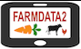
12 – FOSS Project Structures and the FarmData2 Community
COMP 190 – Dickinson College
Fall 2021
Notes:
Today we shift to beginning to look at the FarmData2 project
But we will also consider general structures of FOSS Projects
- how they are organized
- what information they provide
The idea is that by exploring a few of these projects you’ll
- be equipped to navigate a wide range of projects
- expand your perspective on what types of projects are out there
- and how computing can serve the greater good
- the “useful education for the common good” that you have been promised!

Slide 2
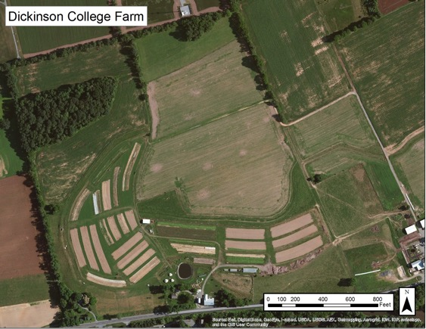
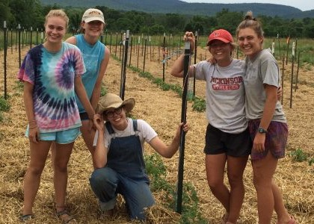
The Dickinson Farm
Dickinson’s College Farm is an 80-acre, USDA-certified organic farm and a living laboratory where students can gain distinctive, hands-on learning experiences.
Notes:
If you haven’t been there
- look for an opportunity to go for an event.
if you are continuing into 290 you will
- take a trip to the farm to see how the farm operates
- learn a little about their processes and vocabulary
- meet the farmer that is helping us with the FarmData2 application.

Slide 3
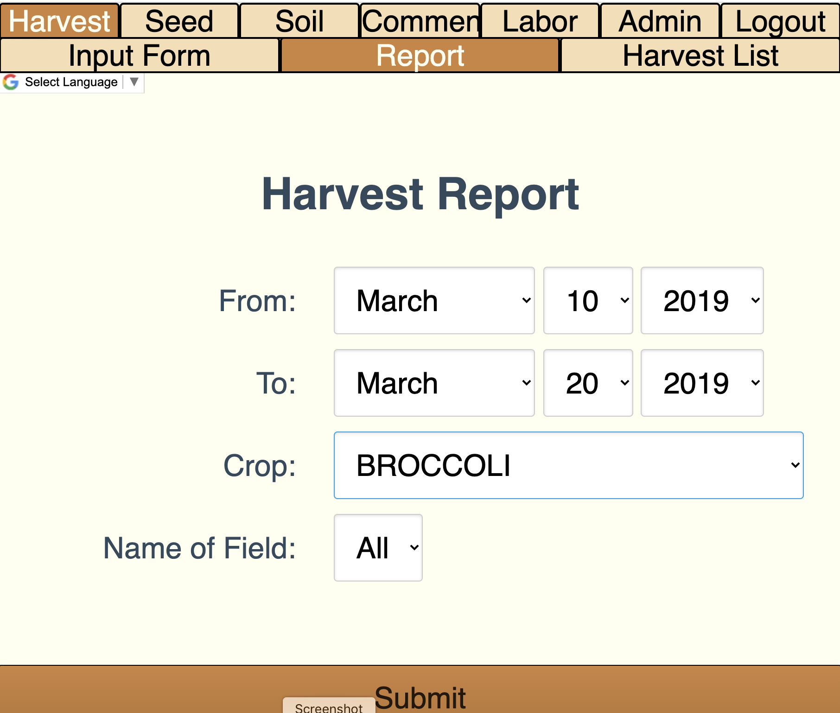
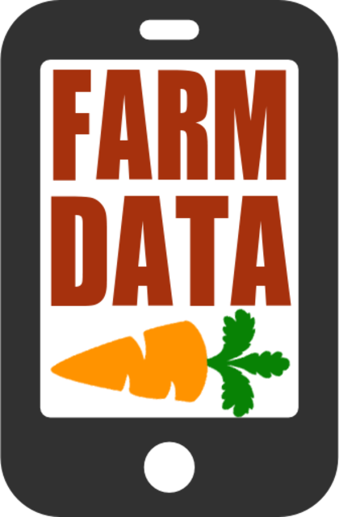
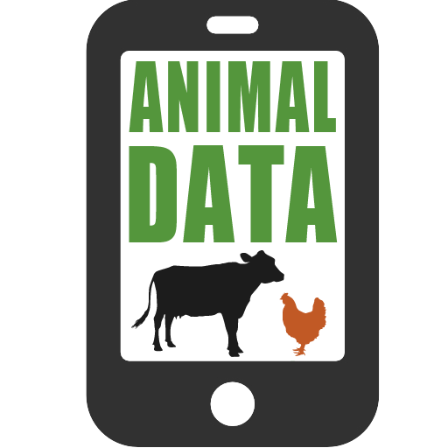
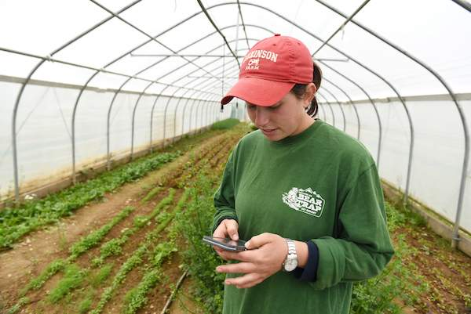
FarmData & AnimalData
Notes:
2011 collaboration between Prof. Tim Wahls and Matt Steiman at the College Farm
Over 5 years
Led to the development of two applications
Used in the field on mobile devices to record data about harvests, growth, pest control, and a host of other things
Used in the barn on desktop machines to plan harvests, track inventory and sales and to maintain records for organic certification.
2016 – We lost Tim to cancer
Development of FarmData and AnimalData stopped.
But interest from the College Farm and other farms that are also using the FarmData app has remained.

Slide 4
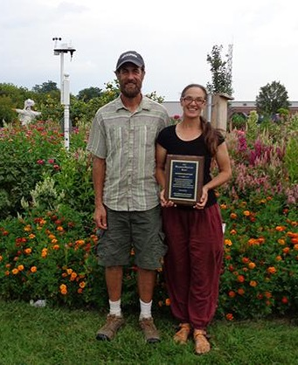
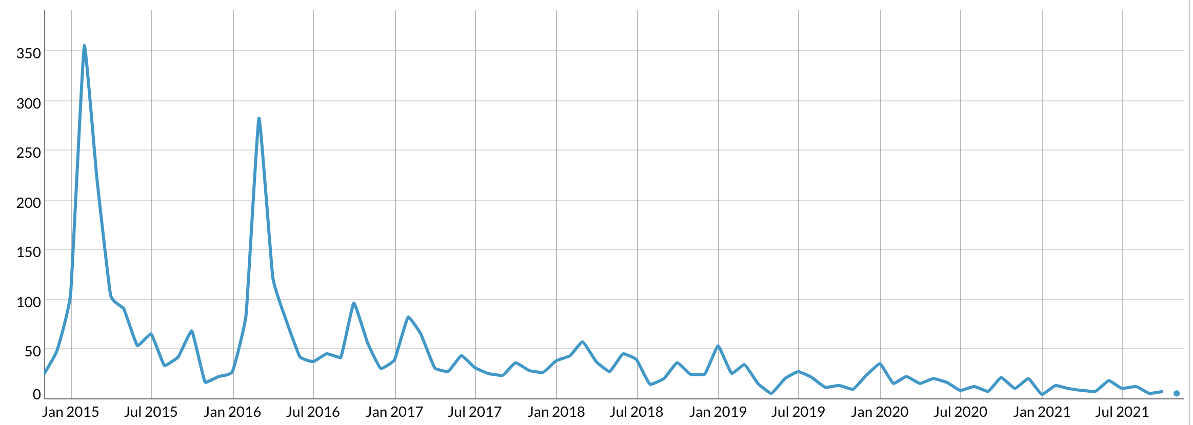
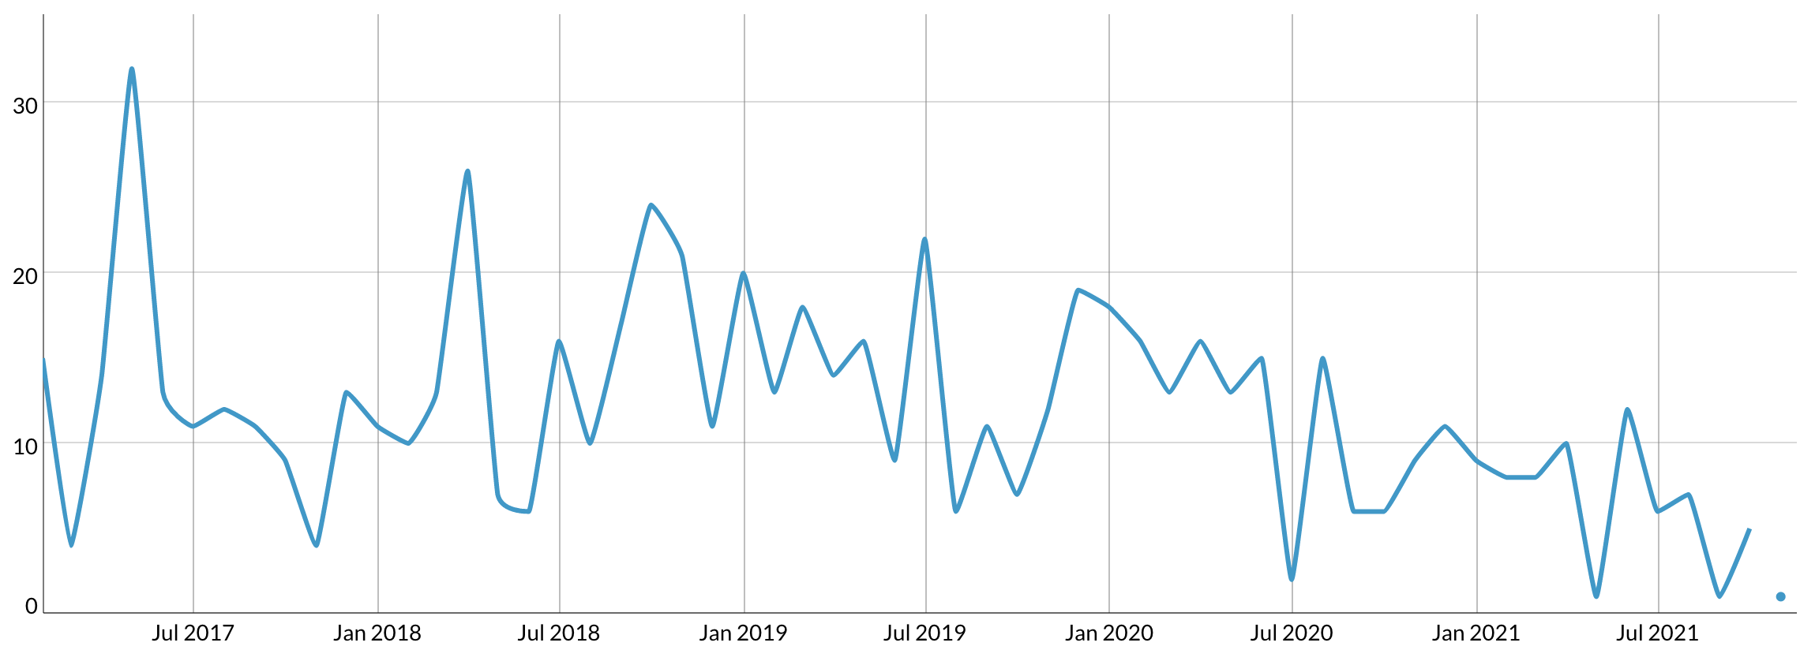
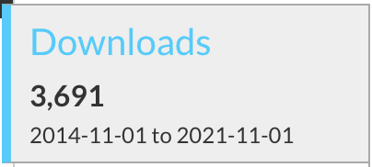
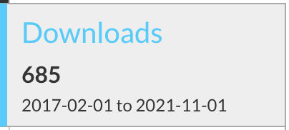
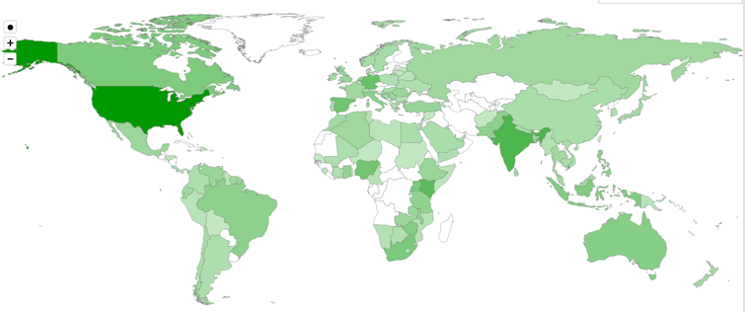
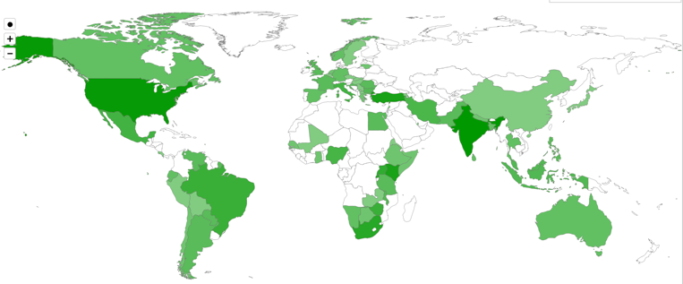
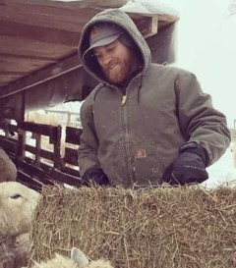
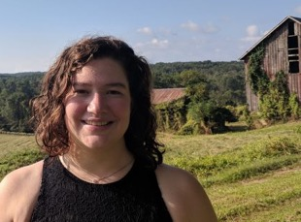
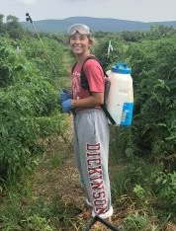
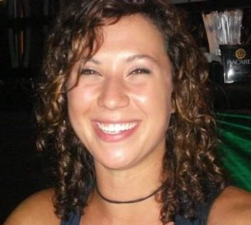
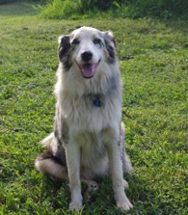
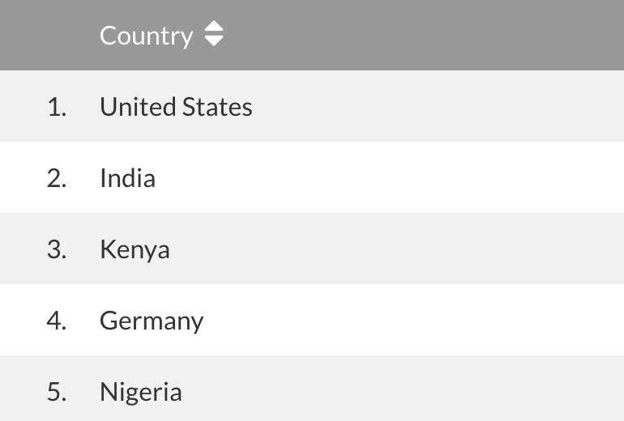
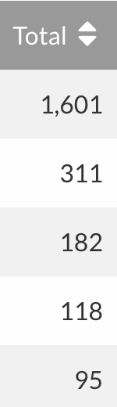
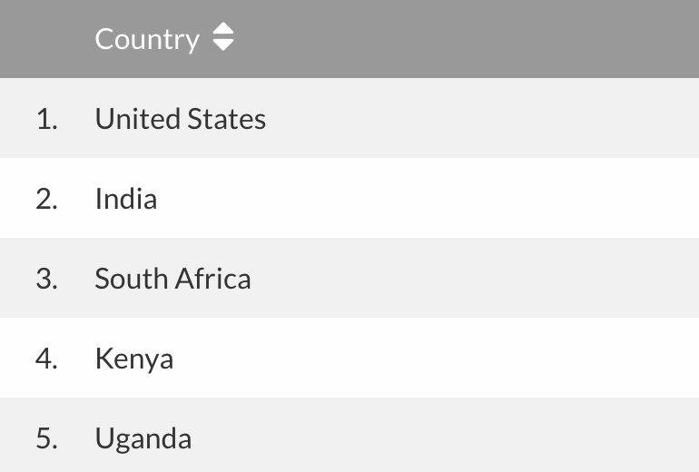
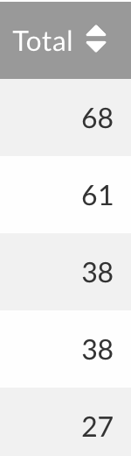
Local Clients, Global Communities
FarmData
AnimalData
Notes:
Matt (Farmer) & Jenn (Farm Manager)
- Tim and Matt talked about the application at a variety of conferences
- Raised awareness of it
- Don’t know how many active users there are
- but it’s been downloaded quite a number of times
- and all over the world.

Slide 5
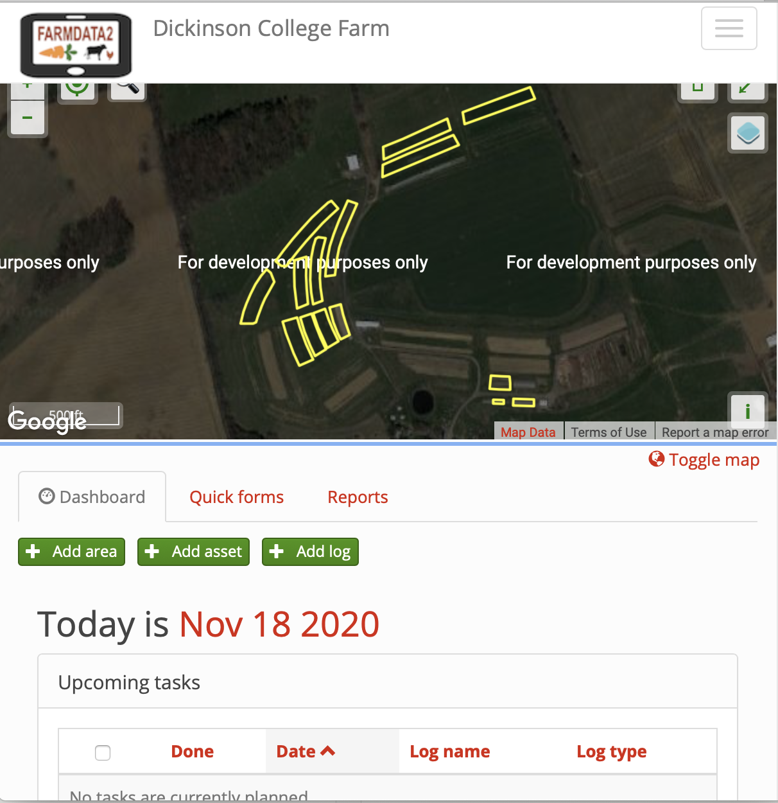
FarmData2
FarmData2 updates and combines FarmData and AnimalData, creating a single application that will support the operation and certification requirements for small organic farming operations.
A living FOSS project and community
Notes:
The CS department has been working on launching the FarmData2 FOSS project
It is a redesign and combination of FarmData and AnimalData
It is built using a more modern tool set
- experience for you.
It is a FOSS project - open to the world.
- Lives on GitHub as you have seen.
- used in this course
- and in COMP 290 where you will:
- learn some web development
- work in teams to add new features to the program.
- Summer Software Development Internships
- 2 each summer
- if you take 290 keep an eye open for those
- Academic year developer positions
- 1 or 2 per semester
- But FarmData2 is also a living FOSS project and community
- have had some developers from around the world chip in with contributions
- working toward engage students/courses from other colleges with organic farms as well.

Slide 6
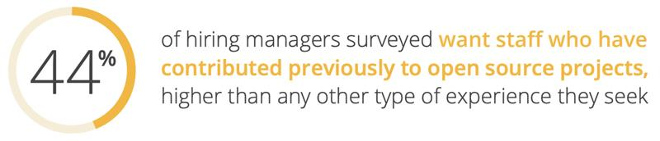
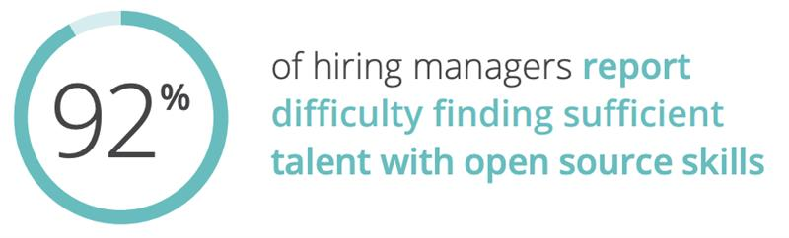
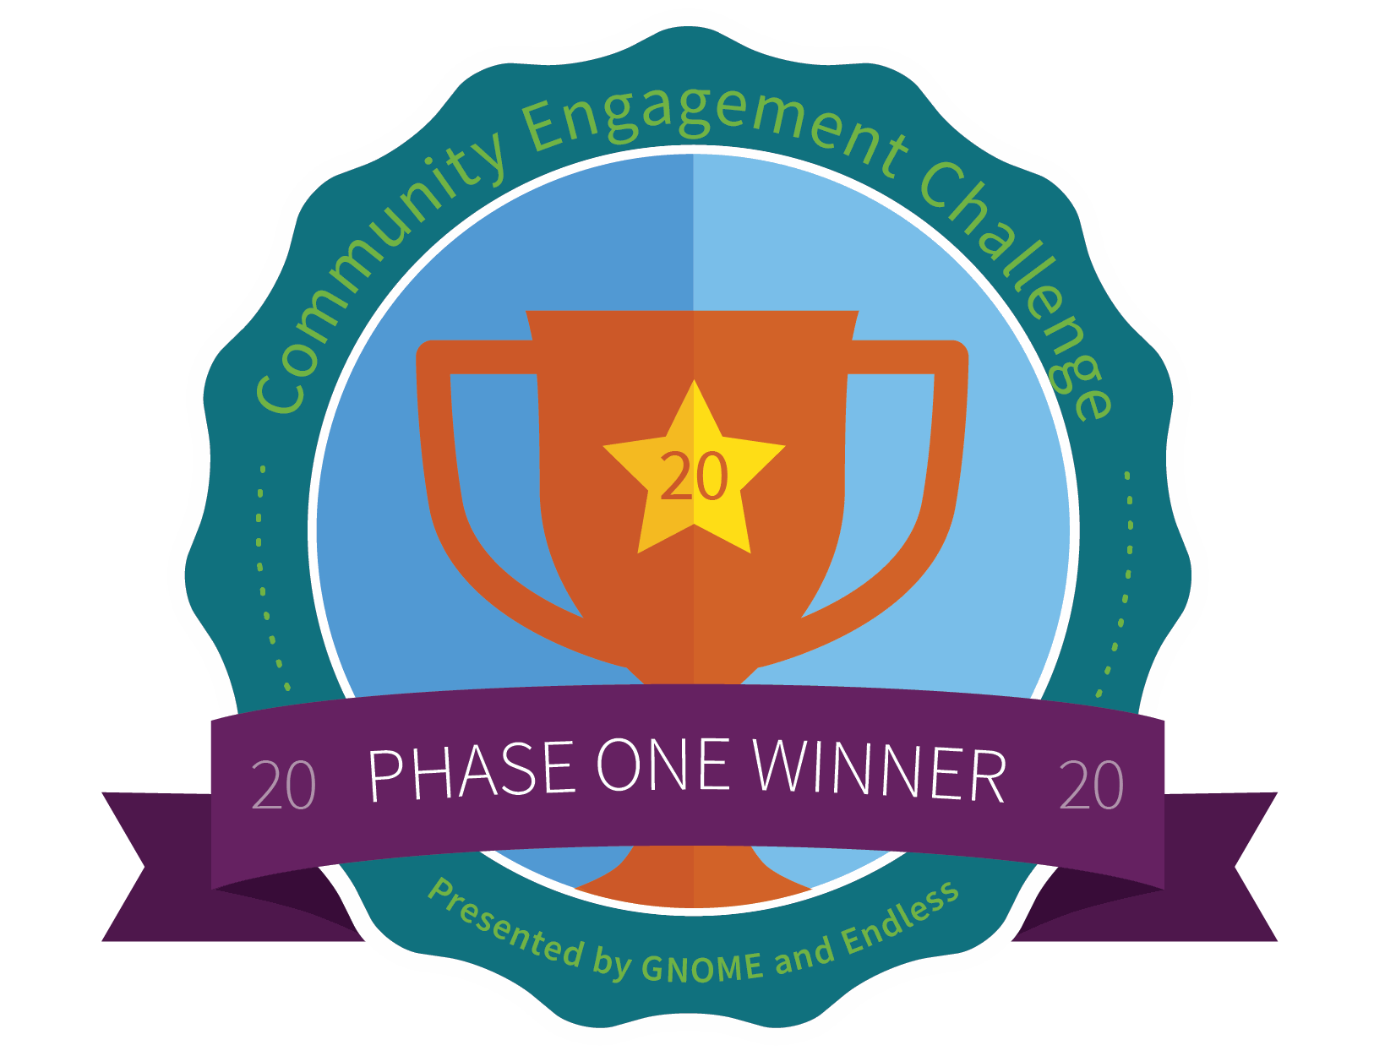
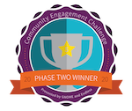
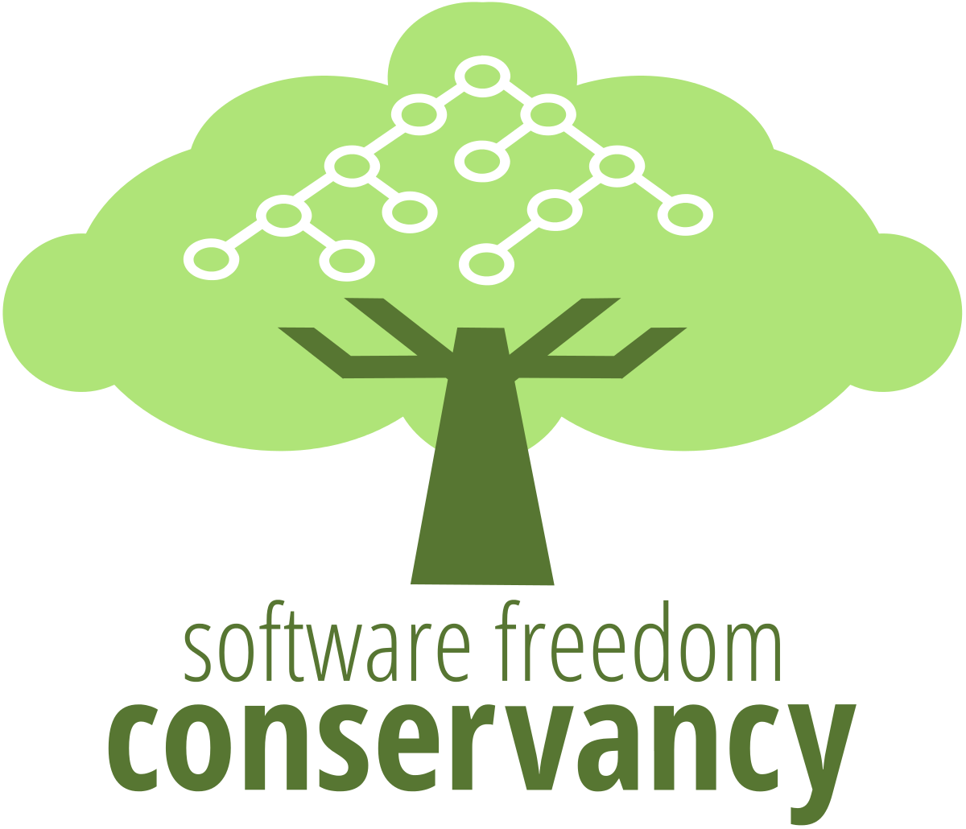


FarmData2 and Dickinson CS
The FarmData2 project and community provide a real-world FOSS platform for authentic experiences in COMP 190 and COMP 290.
Develop skills, knowledge and experiences for success in the senior seminar (COMP 491/492) with FOSS “in the wild” and beyond Dickinson’s limestone walls.
Connect computing with Dickinson’s mission of an “education in service to the common good”
Our approach has received recognition and support from:
The Non-Profit FOSS Institute (NPFI)
Software Freedom Conservancy (SFC)
National Science Foundation (NSF)
The GNOME Foundation
Notes:
Skills knowledge and experiences working in a real project
- version control
- web development
- teamwork
- communication
Prepares you for the capstone experience in the senior seminar
- FOSS ”in the wild”
- Finding and working in an open source community of interest to you.
Gives you an advantage in pursuing internships and jobs.
- Survey by the Linux foundation found that:
- Hiring managers want candidates with open source experience
- Even more so… FOSS experience was the most listed type of experience desired.
- Most hiring managers say it is hard to find candidates with this experience.
What we are doing has gotten some positive attention:
- NPFI – development expertise and support – building engagement with courses at other institutions.
- SFC – supporting development and dissemination of course materials developed here
- NSF – where development of FarmData2, and 190/290/491/491 are part of 5-year $1.9M project looking at using humanitarian foss in the CS curriculum.
- drexel university, western new England college, Worcester State University, Nassau Community College
- GNOME – Our use of FOSS and FarmData in the Dickinson Curriculum selected from 160 international projects as one of 5 finalists in the GNOME Community Engagement challenge – an open source innovation competition – Based on our efforts to broaden participation in computer science through engagement with FOSS with a humanitarian focus.

Slide 7
Activity A12:
Explore a number of Humanitarian FOSS (HFOSS) projects.
Investigate one of interest in a little more depth.
Learn about and observe some of the common documentation shared by FOSS projects.
In an HFOSS project of interest
In FarmData2
Critically evaluate FarmData2 to help improve it.
Join the FarmData2 community.
Notes:
This will set us up to:
- install and run FarmData2 in A13
- Investigate and report some bugs in FarmData2 in A14
- Contribute to the development of FarmData2 in COMP 290.

Slide 8
What’s Next?
A12/Q12 – 1 week
Revise and resubmits
Reading for discussion
Notes:
Should be time to start A12 now.

Slide 9
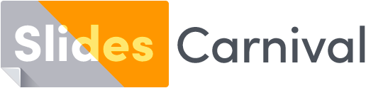
Acknowledgments:
Slide Template From:
https://creativecommons.org/licenses/by/4.0/
Slide Content Licensed as:
https://creativecommons.org/licenses/by-nc/4.0/

